Slide 1
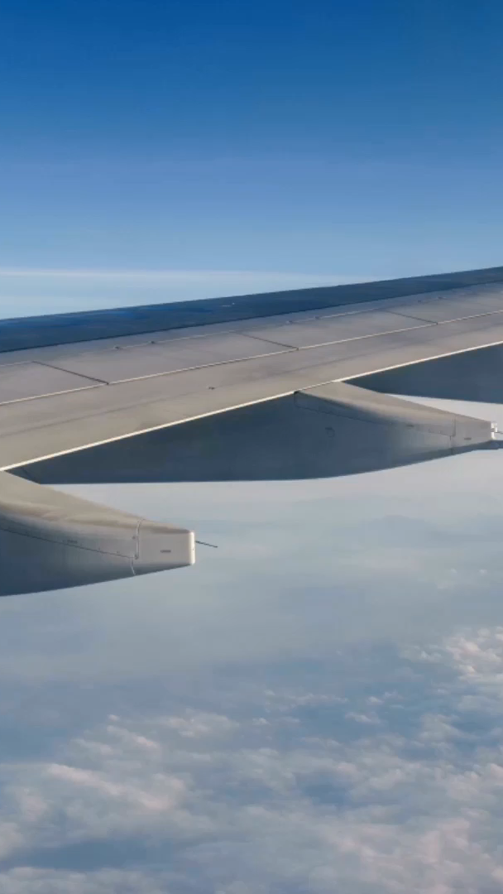

Notes:
Safety first, this a mantra for almost all of us, traveling does not escape from this statement, flying, driving, sealing, how to get to my destination? this questions arise some concerns, and if we focus on lately news, we might think twice if the one of the options is to fly, so if we take a look to some numbers, would you fly?

Slide 2

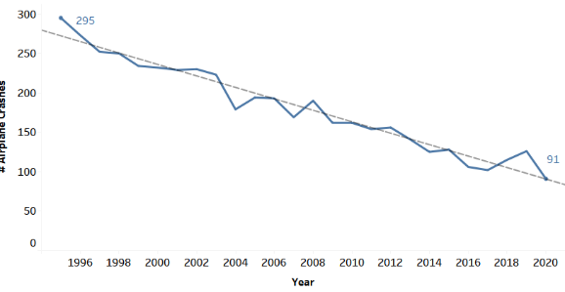
Let’s Fly?
Number of Airplane Crashes
1995
2000
-31%
Flying… Safer every year
Notes:
According to the Bureau of Aircraft Accidents Archives, The number of flights worldwide had a total increase from 2004 to 2019 (before COVID-19 pandemic) of 16.5 millions flights[1]. With this positive trend , an important decrease on airplane accidents has been registered. Airplane Crashes has been decreasing from 1995 to 2020 in about 31% worldwide, this is an indicative that flying has become safer over the years [2]

Slide 3
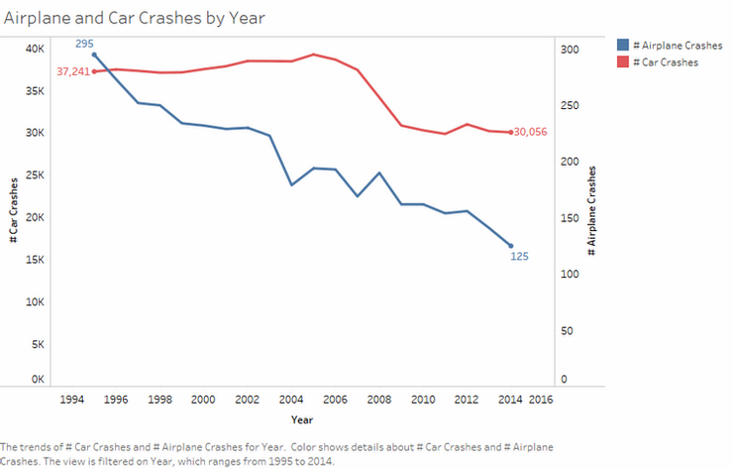
Driving or Flying?
Car accidents are more than 24K% more frequent than Airplane accidents
Notes:
Sometimes flying is not an option, and sometimes driving is not an option, but what about when you can choose? comparing the 2 most popular way to travel, by car and by airplane, the national highway traffic safety administration shows the numbers on this graph, car crashes are more frequent than airplane crashes, as seen here, the numbers are shown in Billions for car crashes (expected because is the most common why to travel). Numbers are shown in units for airplane crashes

Slide 4
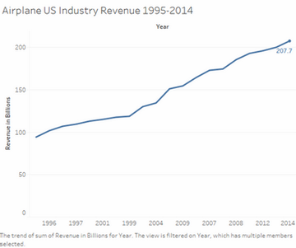
Decisions Made
Notes:
The Airline Data project website have collected the revenue for the United States Airline Industry revenue, and this numbers are shown in this graph from 1996 to 2014, what you can see here is a steadily increasing represent more than 200% growth on the revenue of this industry, this number with the increasing in number of flights is translated in the confident that travelers has been and are giving to the aircraft industry

Slide 5
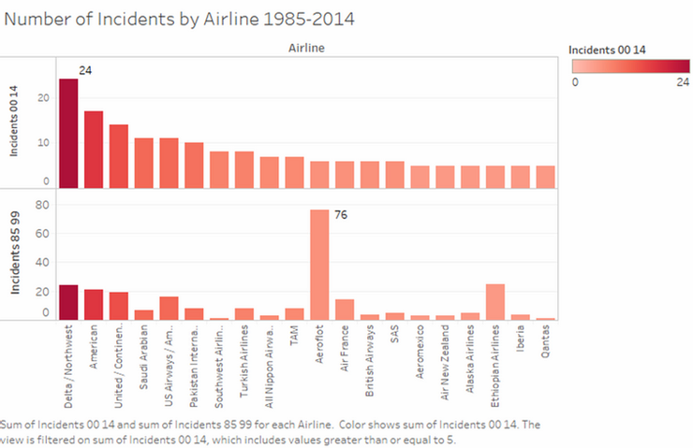
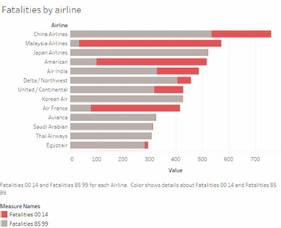
Concerns
Notes:
The airplane industry have had safety issues, this is a real problem, but in the past 14 years it can be considered that incidents have decreased in numbers from 80 to 24, 80 being the highest number between 1985 to 1999 for Aeroflot Airlines and 24 being the highest number between 2000 to 2014 for Delta/Northwest Airlines. In the following representation we can see how the number of fatalities on airplane crashes has been decreasing for most of the airlines but for 2, Malasya airline as we could see on the tree map shown before, American Airline, and for Airfrance, this graph shown most of the airline that have report incidents have decrease number of losses.

Slide 6
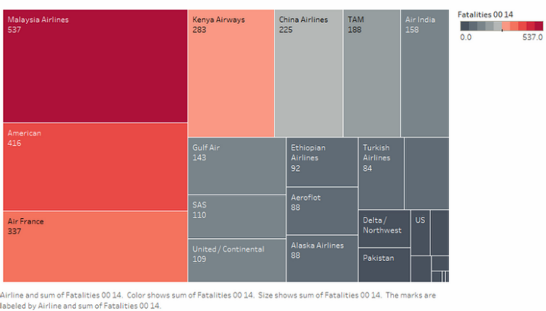
Concerns
Notes:
Most of airplane crashes are fatal, and this becomes a serious problem for people that think on flying
Some airplane fatal crashes has been known or heard worldwide, this is a representation of the worst numbers for the industry by airline.

Slide 7
Notes:
Safety First, taking in consideration facts is important
knowing what it’s happening can help us to take decisions based on facts,
Airline Safety have had red numbers as we can saw, but this statistics shows that these incidents has been and are being considered and analyzed to improve safety in the industry
the visualizations shown before demonstrate decreasing numbers over the last years, and compared with car traveling, flying is safer… Have a safe flight

